Slide 1
RHMS-Climate service attended trainings:
Using Grided Satelite Data in Climate Services, on line fase 16-27 April 2018
- 5th CM SAF User Workshop and the 1st Advanced Training Course for CM SAF users, Mainz, Germany 3-7 Jun 2019
Upon trainigs RHMS has used
EUMETSAT /CMSAF satellite products in climatology purpose
A few examples of SDU,SIS,LST,CFC,SOL are presented in the next slides

Slide 2
SDU-sunshine duration
LST-land surface temperature

Slide 3
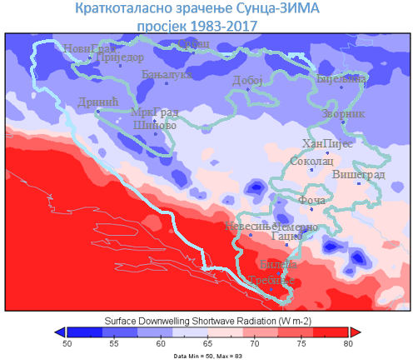
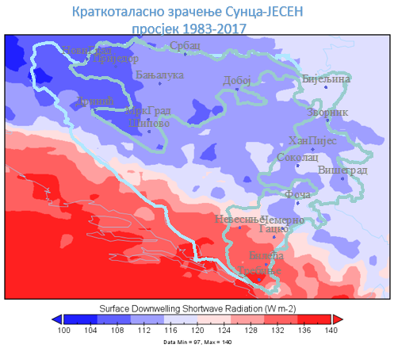
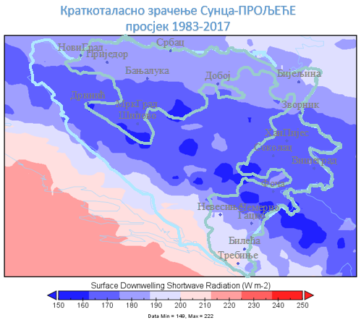
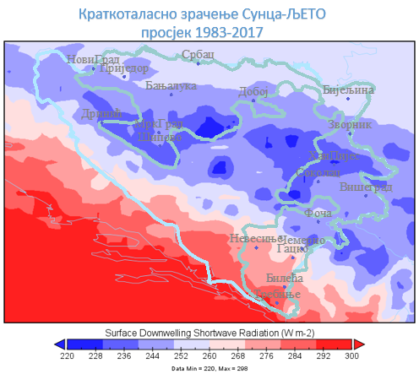
SIS-seasons

Slide 4
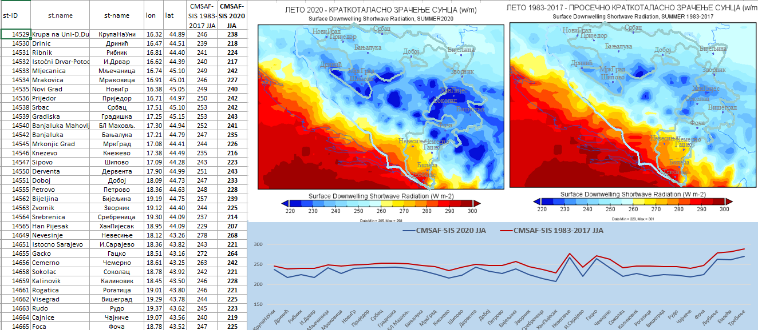
SIS – surface downwelling shortwave radiation

Slide 5
CLOUD FRACTION [%]

Slide 6
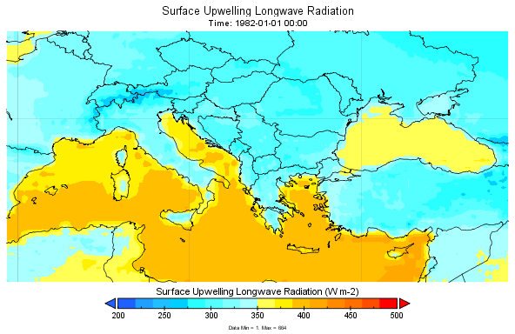
SOL – Surface upwelling longwave radiation

Slide 7
SOL – Surface upwelling longwave radiation

